Slide 1

Whitford Country Club
A Database Project by Mark Miller

Slide 2

Table of Contents:
Cover Page……………………………………………………... pg 1
Table of Contents……………………………………………. pg 2
Executive Summary…………….…………………………. pg 3
ER Diagram…………………….……………………………….. pg 4
Tables…….………………………………………………………… pg 5
Persons Table……………………………………….... pg 5
Employee Table………………………………………. pg 6
Member Table…………………………………………. pg 7
AquaticDirector Table……………………………. pg 8
Lifeguard Table…………………………………….. pg 9
Chef Table……………………………………………. pg 10
Waiter Table………………………………………… pg 11
Manager Table…………………………………….. pg 12
Privilege Table……………………………………. pg 13
JobTask Table……………………………………… pg 14
CountryClubDues Table………………………. pg 15
Payment Table……………………………………. pg 16
PaymentInfo Table……………………………… pg 17
Views………………………………………………………….. pg 18
LifeguardInfo View………………………...... pg 18 AquaticDirectorInfo View………………….. pg 19
ChefInfo View……………………………………….. pg 20
WaiterInfo View……………………………………… pg 21
ManagerInfo View…………………………………… pg 22
CCMemberInfo View………………………………. pg 23
PayDeterminate View……………………………. pg 24
CCMemberDues View…………………………….. pg 25
Stored Procedures………………………………………... pg 26
getPersonInfoByName……………………………. pg 26
getEmployeeInfo……………………………………. pg 27
getMemberInfo…………………………………….… pg 28
Reports………………………………………………………….. pg 29
Employee Payment Info………………………... pg 29
Member Dues Info………………………………... pg 30
Trigger…………………………………………………………… pg 31
Trigger Functions……………………………………. pg 31
Trigger Function…………………………………….. Pg 32
Inserts for Trigger………………………………….. pg 33
Sample Data for Trigger………………………… pg 33
Security………………………………………………………….. pg 34

Slide 3
Executive Summary:
Whitford Country Club, located in the small town of Exton, is a pristine Country Club with a prestigious golf course for the area along with a fantastic community. WCC is also home to a terrific staff that runs the outside pool in the summer, yet has had trouble in the past with managing all of its Employees. So I decided to go ahead and make a database proposal for the CC.
The objective of this proposal is first to make sure all information is persevered and never lost. They had an incident in which some important data was lost and unable to be recovered. Secondly, to organize the data so it is easier to view and understand. Finally, the last was to all around create a better more organized database for the Whitford Country Club.
The Database is currently a work in progress but is a general idea and layout that is meant to server as a proposal for a new Database system. As we move forward we will continue to add, update, and revise the Database in order to make it the best possible solution for the problems that Whitford Country Club faces.

Slide 4
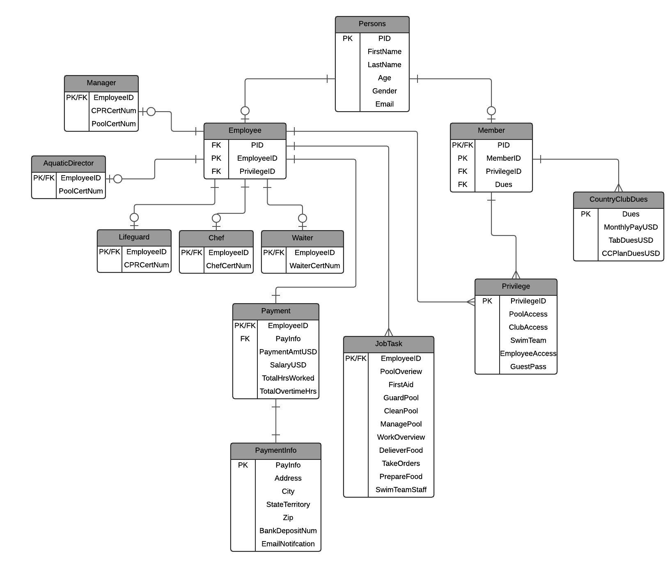
ER-Diagram

Slide 5
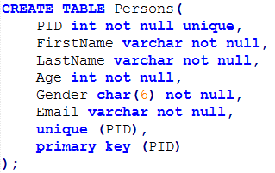
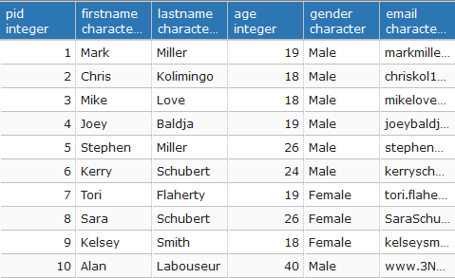
Create Table Statements: Persons Table
Functional Dependencies:
PID → FirstName, LastName, Age, Gender, Email
This is the most important table as it is the beginning in which we distinguish every person with a PID, name and important information about themselves. The PID is the primary key as it acts as the beginning to distinguishing a member from an employee.
Sample data:

Slide 6
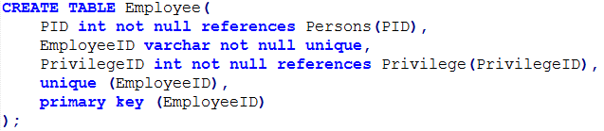
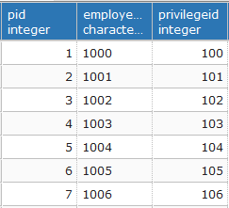
Create Table Statements: Employee Table
The Employee Table places a crucial role as it links many of the other tables that are associated with an employee. We also define and store the EmployeeID into this table. This table references the Persons table through the PID and uses the EmployeeID as its primary key. There is a decision node placed on the employee side because of the choice between a employee or member.
Functional Dependencies:
EmployeeID → PID, PrivilegeID
Sample data:

Slide 7
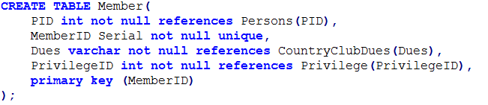
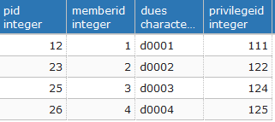
Create Table Statements: Member Table
Another crucial table as it links all member related table to it by a MemberID. The MemberID servers as the primary key and references the Persons table by the PID. Again we place a decision node on the member side because you can either be a member or an employee.
Functional Dependencies:
MemberID → PID, Dues, PrivilegeID
Sample data:

Slide 8
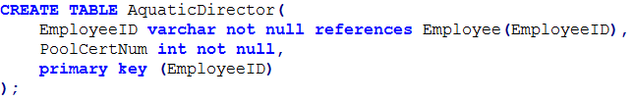

Create Table Statements: AquaticDirector Table
This is one of many jobs that are associated with being an Employee. EmployeeID is again the primary key and references the Employee Table. The AqauticDirector also has a Pool Certificate Number associated with him. A decision node is placed on this side as it is a job decision.
Functional Dependencies:
EmployeeID → PoolCertNum
Sample data:

Slide 9
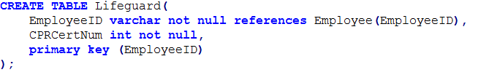
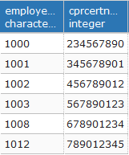
Create Table Statements: Lifeguard Table
Another job associated with being an Employee and follows the same principles as the AquaticDirector table. It references EmployeeID and has an CPR Certificate Number associated with it too. We again place a decision node on this side of the table to show the choice of being a lifeguard.
Functional Dependencies:
EmployeeID → CPRCertNum
Sample data:

Slide 10
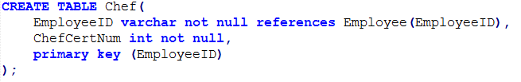
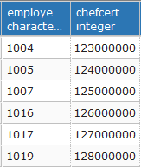
Create Table Statements: Chef Table
Following the other job tables, this table sets the primary key as the EmployeeID and references the Employee table with it. The Chef table also has a Chef Certificate Number within it. The decision node is used on this side of the table to show the choice of being a chef.
Functional Dependencies:
EmployeeID → ChefCertNum
Sample data:

Slide 11
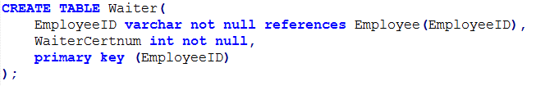
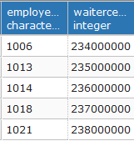
Create Table Statements: Waiter Table
The waiter table follows all other job tables in that we set the EmployeeID as the primary key and reference the Employee table to get it. The Waiter table also as a Waiter Certificate number corresponding with it. A decision node is used to show a decision is made on choosing this job.
Functional Dependencies:
EmployeeID → WaiterCertNum
Sample data:

Slide 12
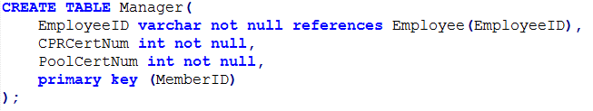
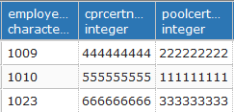
Create Table Statements: Manager Table
The final job table is the Manager table. This again sets the EmployeeID to be the primary key and references the Employee table to get it. It then also has both a CPR and Pool Certificate Number in its table. Like the rest a decision node is used to represent the choice between a manager or any other job.
Functional Dependencies:
EmployeeID → PoolCertNum, CPRCertNum
Sample data:

Slide 13
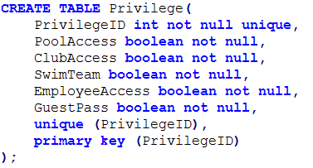
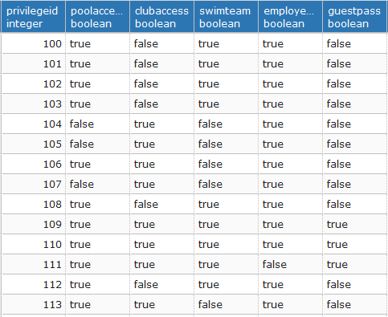
Create Table Statements: Privilege Table
Functional Dependencies:
PrivilegeID → PoolAccess, ClubAccess, SwimTeam, EmployeeAccess, GuestPass
The privilege table represents the privileges that each employee or member has access to. The PrivilegeID is stored within this table and is referenced in both the employee and member table. The PrivilegeID is used as the primary key in this table.
Sample data:

Slide 14
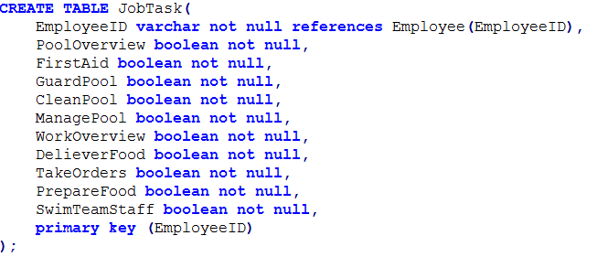
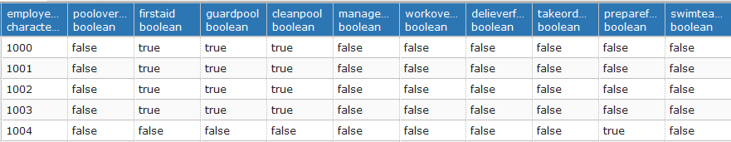
Create Table Statements: JobTask Table
This table is very similar to the Privilege table in that it defines all of the job task assigned to a specific person. We use the EmployeeID as the primary key and references the Employee table once again.
Functional Dependencies:
EmployeeID → PoolOverview, FirstAid, GuardPool, CleanPool, ManagePool, WorkOverview, DelieverFood, TakeOrders, SwimTeamStaff
Sample data:

Slide 15
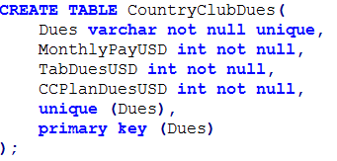
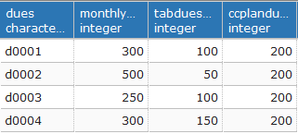
Create Table Statements: CountryClubDues Table
This table signifies all of the payments that a member must make to the Country Club. We use Dues as the primary key and store it within this table. Dues is referenced by the Member table in order to gain access.
Functional Dependencies:
Dues → MonthlyPay, TabDues, CCPlanDues
Sample data:

Slide 16
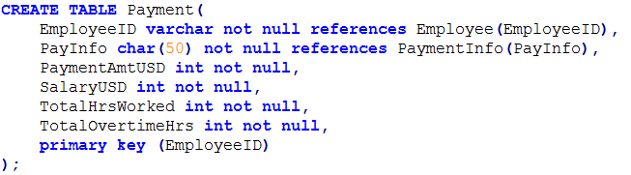
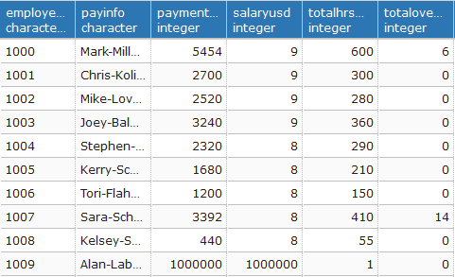
Create Table Statements: Payment Table
This table uses a EmployeeID once again as its primary id and describes all of the factors that go into your payments and the total payment that you get.
Functional Dependencies:
EmployeeID → PAyInfo, PaymentAmt, Salary, TotalHrsWorked, TotalOvertimeHrs
Sample data:

Slide 17
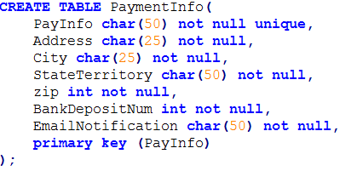
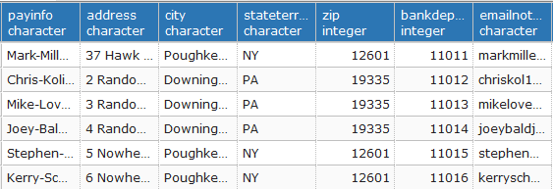
Create Table Statements: PaymentInfo Table
The final table in our database is the PaymentInfo table which specifies all of the needed information when a employee is being paid. The primary key is the PayInfo which is unqiue for every person.
Functional Dependencies:
PayInfo → Address, City, StateTerritory, zip, BankDepositNum, EmailNotification
Sample data:

Slide 18
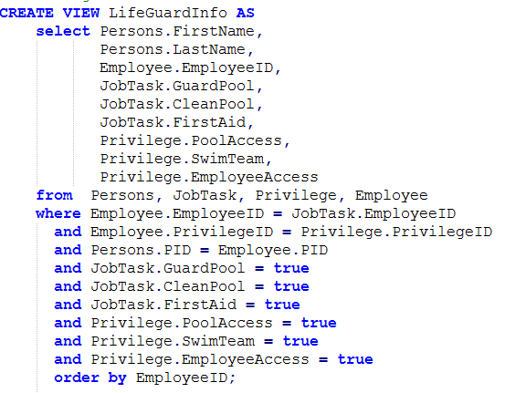
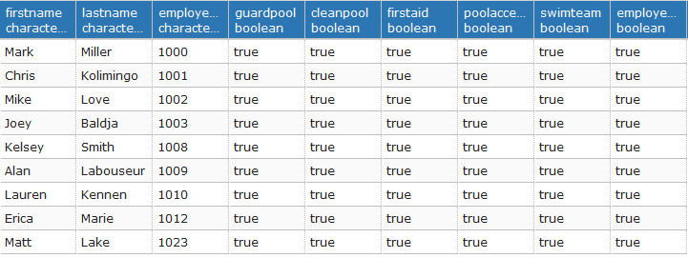
LifeGuardInfo View
This View displays all employees who have the same privileges and job tasks that fits the Lifeguard description. It identifies them by their name and lists there EmployeeID in ascending order.
Sample data:

Slide 19
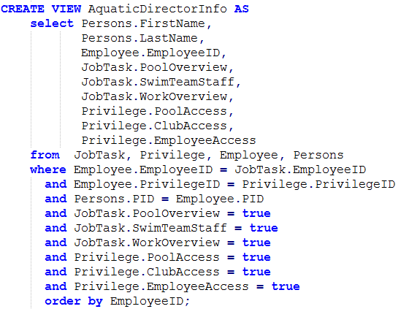
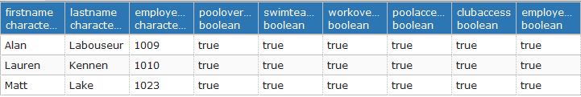
AquaticDirectorInfo View
This View displays all employees who have the same privileges and job tasks that fits the Aquatic Director description. It identifies them by their name and lists there EmployeeID in ascending order.
Sample data:

Slide 20
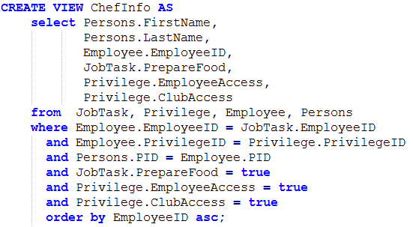
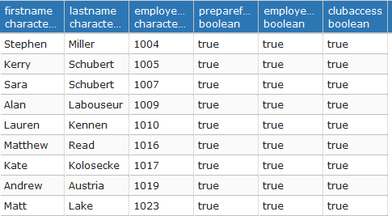
ChefInfo View
This View displays all employees who have the same privileges and job tasks that fits the Chef description. It identifies them by their name and lists there EmployeeID in ascending order.
Sample data:

Slide 21
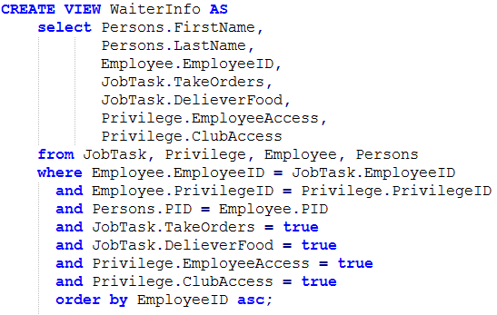
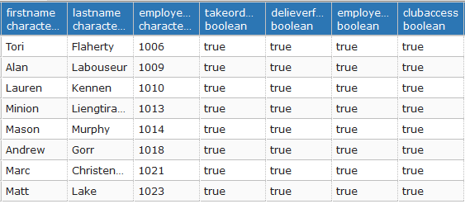
WaiterInfo View
This View displays all employees who have the same privileges and job tasks that fits the Waiter description. It identifies them by their name and lists there EmployeeID in ascending order.
Sample data:

Slide 22
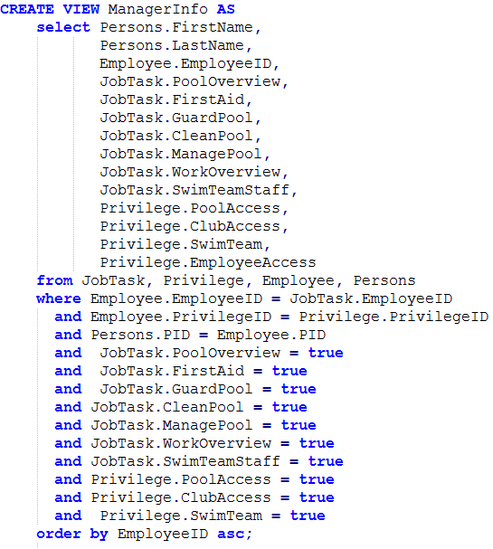
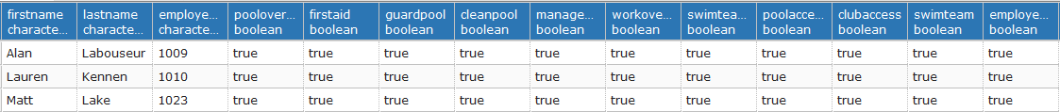
ManagerInfo View
This View displays all employees who have the same privileges and job tasks that fits the Manager description. It identifies them by their name and lists there EmployeeID in ascending order.
Sample data:

Slide 23
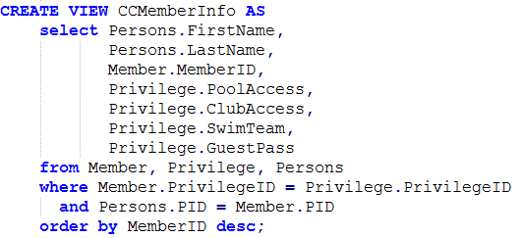
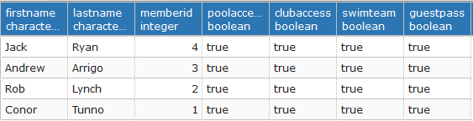
CCMemberInfo View
This view displays all of the current Country Club Members and identifies that they all have access to the specified Member privileges.
Sample data:

Slide 24
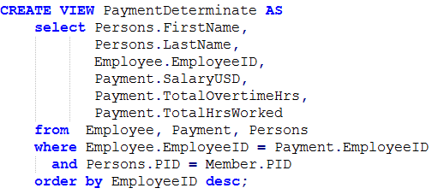
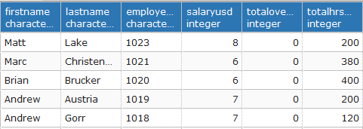
PaymentDeterminate View
In this View we are listing all of there names and employee numbers in a descending order. Then were are display the main components that going into factoring the persons total pay (PaymentAmt). These are the determinates used to find the total pay for that employee.
Sample data:

Slide 25
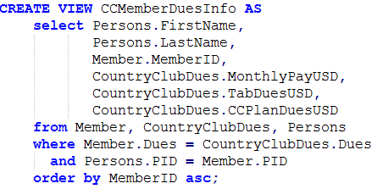
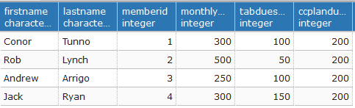
CCMemberDues View
This view does the same as the PayDeterminate Table, but instead it list all of the members. It then displays their MemberID and then displays each of the payments that add up to there total Dues.
Sample data:

Slide 26
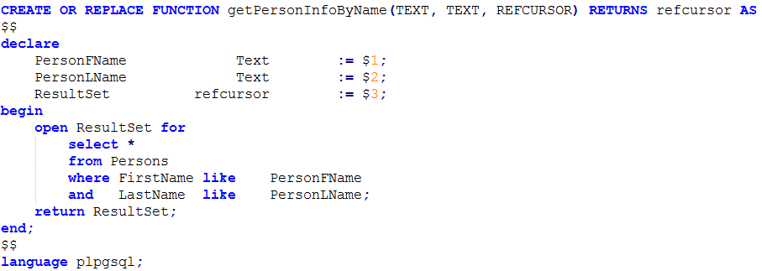

getPersonInfoByName Stored Procedure
This stored procedure takes a first name and last name and searches through the Persons table and finds all matches. When it finds this match it list the persons PID, first name, last name age, email, and gender.
Sample data:

Slide 27
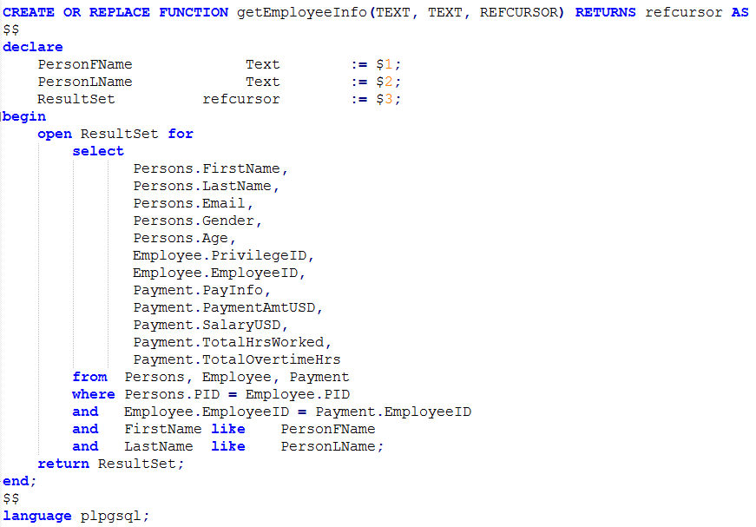
getEmployeeInfo Stored Procedure
This stored procedure takes a first name and last name and searches through the Employee table and finds all matches. When it finds this match it list the Employees information.
Sample data:

Slide 28
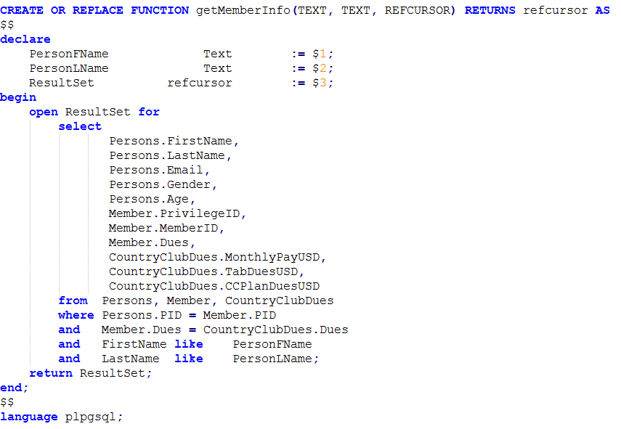

getMemberInfo Stored Procedure
This stored procedure takes a first name and last name and searches through the Member table and finds all matches. When it finds this match it list the Members information.
Sample data:

Slide 29
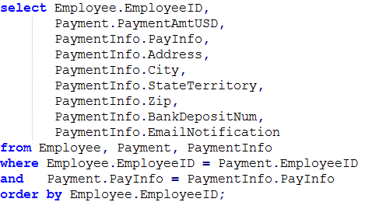
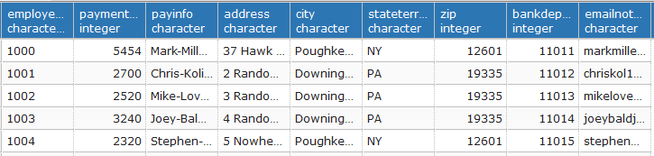
Report: Employee Payment Info
This Report returns all the employees that we currently have and returns there Payment Information (PaymentInfo) to us so we have easy access to it.
Sample data:

Slide 30
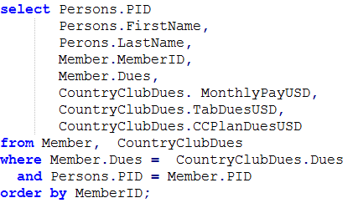
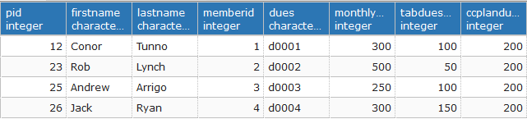
Report: Member Dues Info
This Report returns all the Members that we currently have and returns there current dues they owe (CountryClubDues) to us so we have easy access to it.
Sample data:

Slide 31
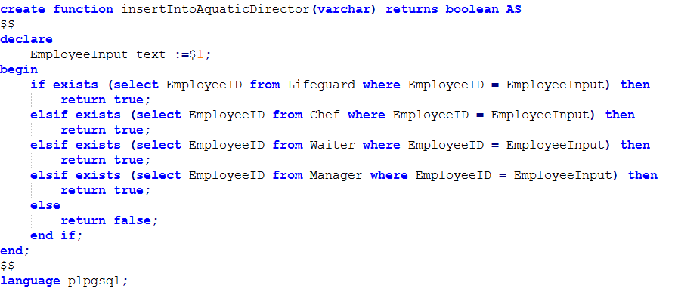

Trigger Functions
These are the functions that allow the trigger to work. They check all tables to see if the EmployeeID is already in it. If it is it then returns true otherwise returns false.

Slide 32

Trigger Function
This function takes the previous trigger functions we created for this and use it in this trigger so that whenever we try to add into a job table it will automatically check to see if the Employee is already in another table or not.

Slide 33


Inserts for the Trigger and Sample Data
These are the inserts for the trigger so that the trigger will work properly.
Sample Data For Trigger:

Slide 34



Security:
The Whitford Vice president is someone appointed by the President, usually a member and has some access. He is only allowed to access, insert, and update on people and the jobs that they have.
The Whitford Administration is a big help to the boss himself. They have access to all table but again they are only allowed to select, insert and update the tables. They do not have the the delete function.
The final security given is to the President or the Big Man on duty. He has access to all tables and all functions. He is the only one allowed to have access to the delete function in order to keep everything in tact.

